Slide 1
Detecting Introgressed Haplotypes with Deep Learning
Dan Schrider
University of North Carolina at Chapel Hill

Slide 2

Speciation followed by gene flow
a
b
a
b
A
b
a
B
A
b
a
B
A
b
a
B

Slide 3

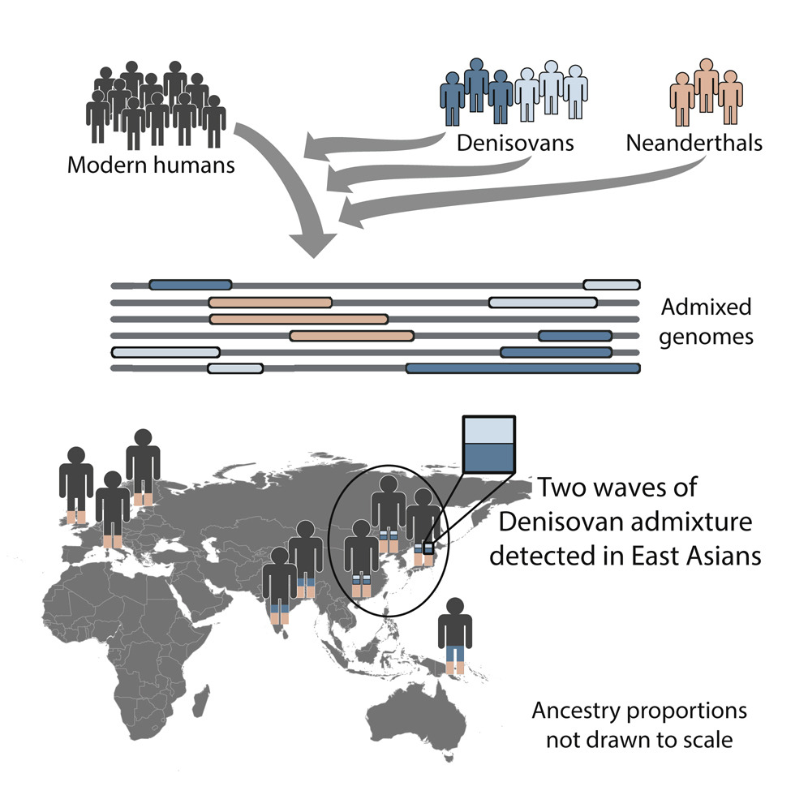
Adaptive introgression
Huerta-Sánchez et al. (2014)

Slide 4
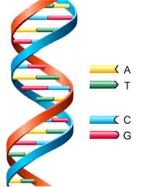
Detecting genomic windows with introgressed material
vs.

Slide 5
Detecting introgression with summary statistics
Geneva et al. (2015); Rosenzweig et al. (2016)

Slide 6
Detecting introgression with summary statistics
d_{min}
Geneva et al. (2015); Rosenzweig et al. (2016)

Slide 7
Detecting introgression with summary statistics
d_{min}

Slide 8
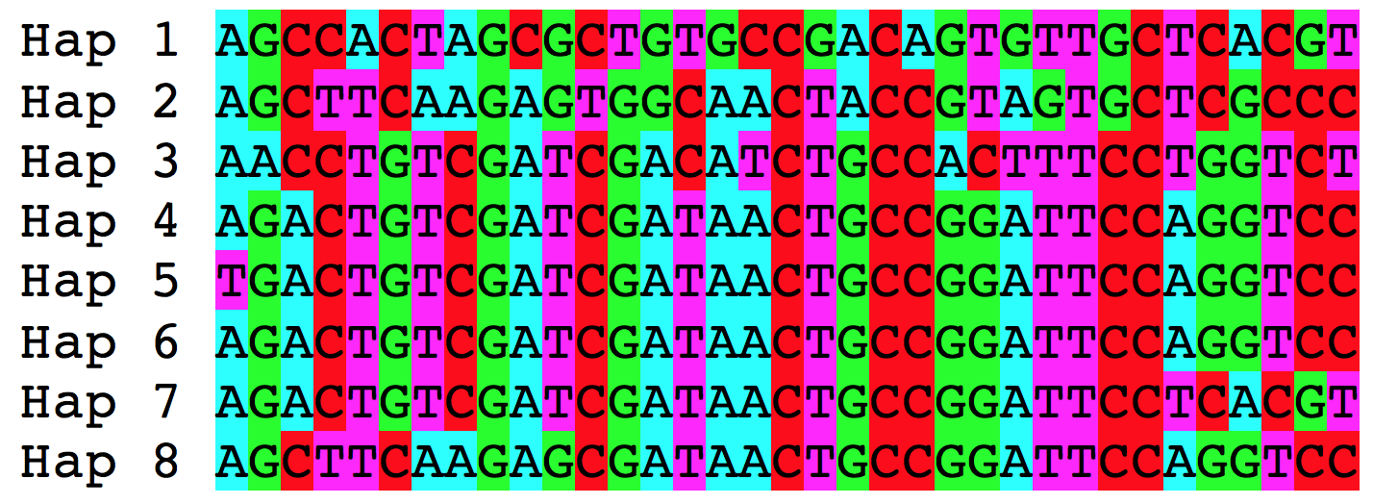
Evolutionary inference as detective work
Infer presence of phenomenon of interest
Introgression or no?
Capture properties of genealogy with summary statistics
d_{min}
Sequence alignment

Slide 9
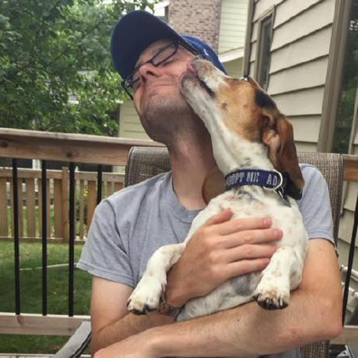

Inference via Convolutional Neural Network (CNN)
Infer presence of phenomenon of interest
Capture properties of genealogy with summary statistcs
Lex Flagel
Sequence alignment
CNN image credit: Ryan Marchildon

Slide 10
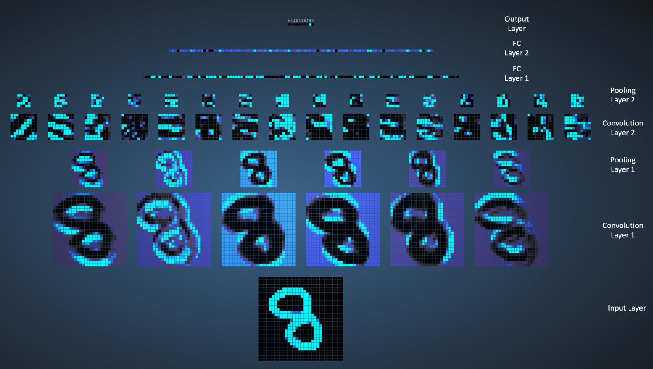
Convolutional Neural Network (CNN)
image made by Ujjwal Karn using Adam Harley’s awesome interactive tool

Slide 11
Convolutional filter layer
1 | 3 | 4 | 4
2 | 1 | 5 | 3
4 | 2 | 2 | 1
1 | 1 | 4 | 2
4 | 9 | 12
8 | 5 | 8
6 | 7 | 8
1 | 0
1 | 1
Filter
1*1 + 3*0 + 2*1 + 1*1 = 4
Input matrix
3*1 + 4*0 + 1*1 + 5*1 = 9
…
2*1 + 1*0 + 4*1 + 2*1 = 8

Slide 12
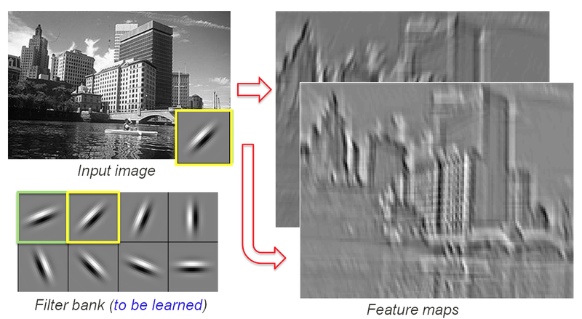
Convolutional filter layer
image made by Rob Fergus

Slide 13
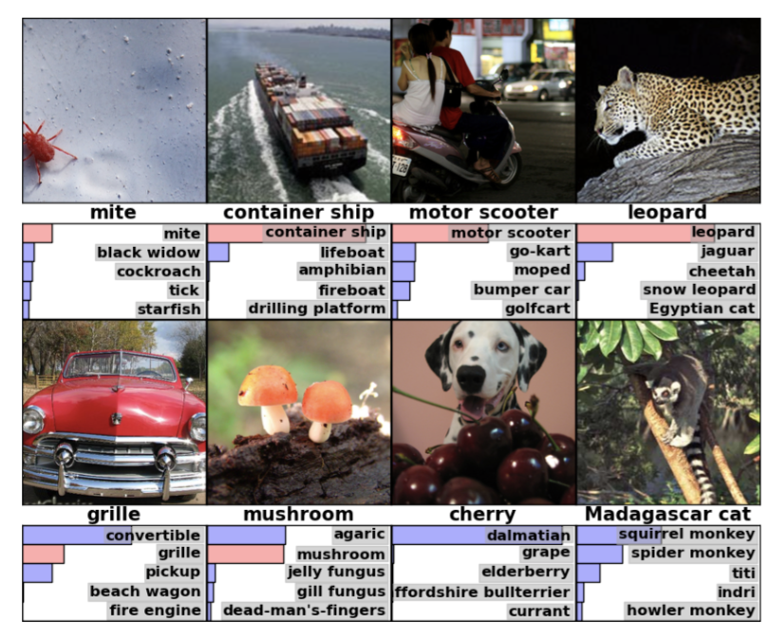
ImageNet Challenge

Slide 14
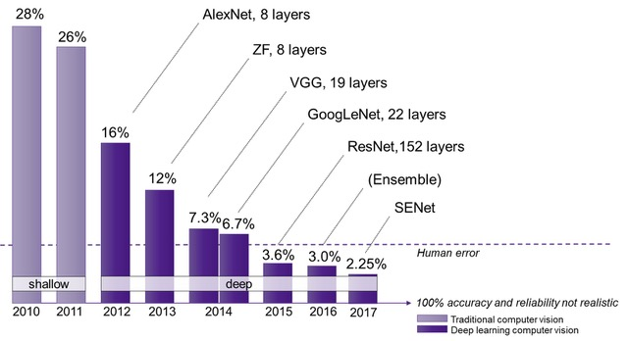
CNNs broke the ImageNet Challenge
Krizhevsky et al. (2012): arguably the start of the revolution

Slide 15
What if this is our “image”?
…
Samples
Genomic positions
What can we infer about a population sample’s evolutionary history using a CNN?

Slide 16
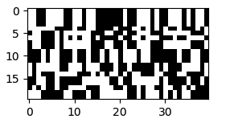
What if this is our “image”?
…
Samples
Genomic positions
What can we infer about a population sample’s evolutionary history using a CNN?

Slide 17
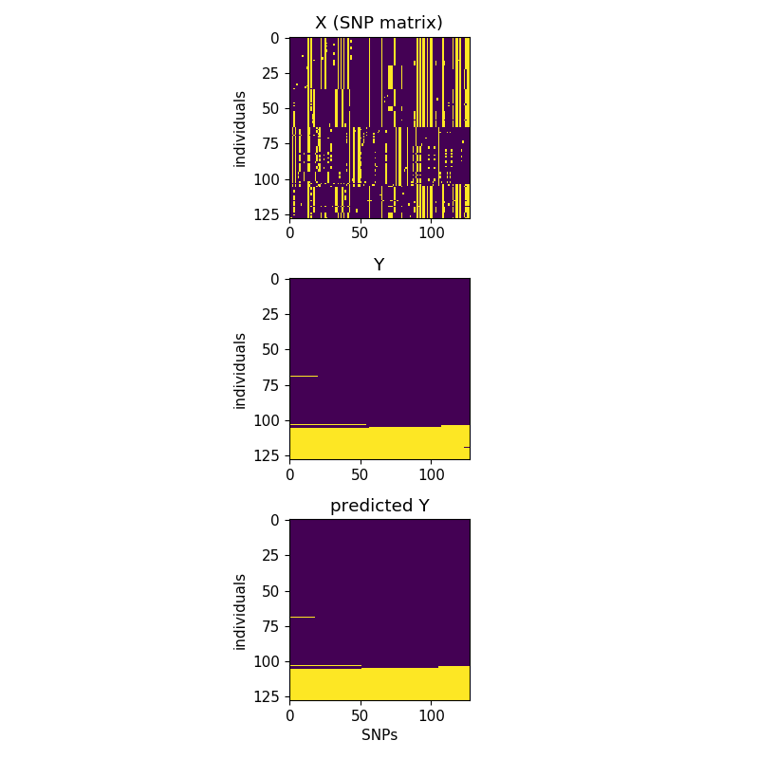
Using a CNN to detect introgressed windows
Input alignment
Population 1
Population 2
Polymorphisms
Is there any introgression here?
Or not?
Can we do better than this?

Slide 18
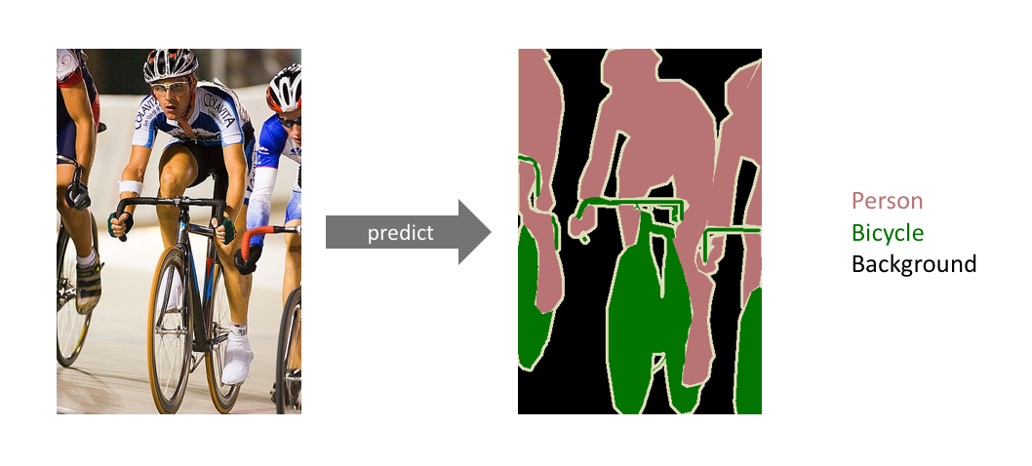
Localizing introgression via Semantic Segmentation
Input alignment
Introgressed haplotypes
Prediction
Population 1
Population 2
SNPs
SNPs
SNPs

Slide 19
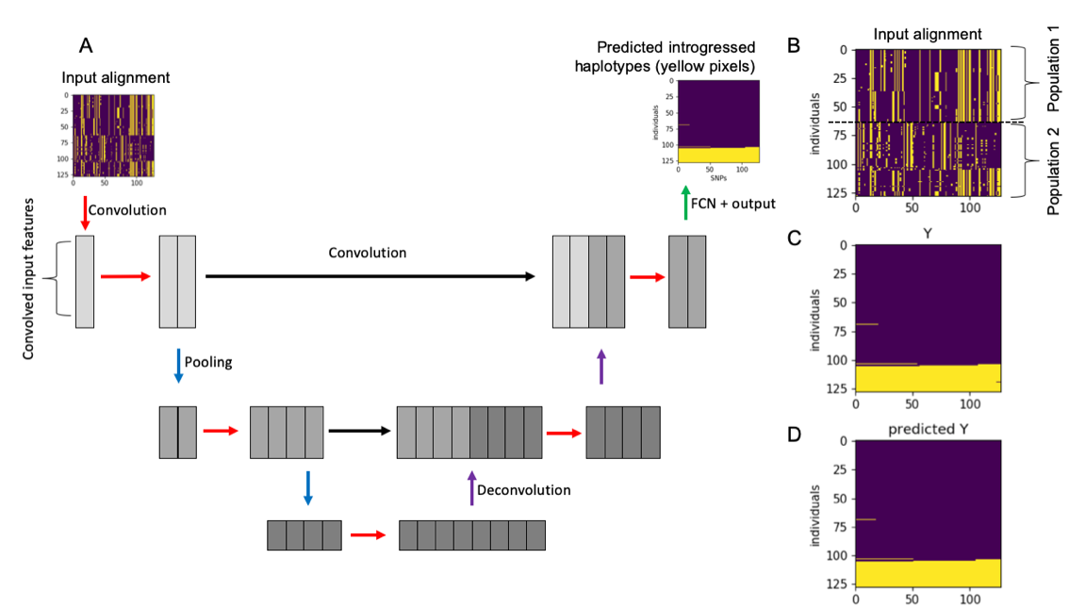
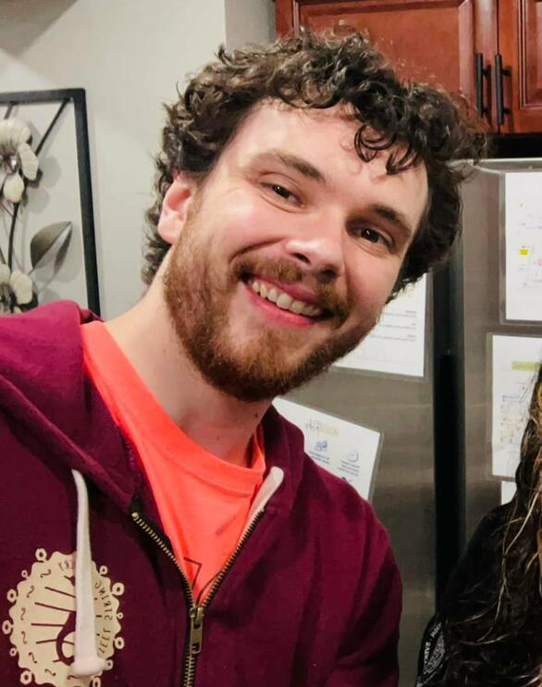
UNET for detecting introgression
SNPs
Dylan Ray
Ray et al. (2024, PLoS Genetics)

Slide 20
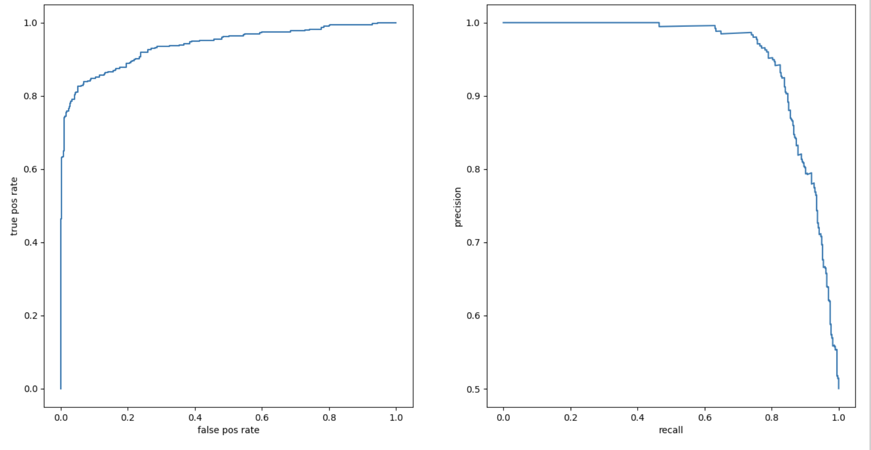
Workflow
Input alignment
Simulate training data
Format/arrange data
Design neural network
Train it
Test it!
Apply to data
SNPs

Slide 21
Actually, we will train two networks
Then, we identify introgressed haplotypes within these windows
First, we identify genomic windows with introgression
Yes
Input alignment
Introgression in this window?
No
SNPs
SNPs
On to the next window!

Slide 22
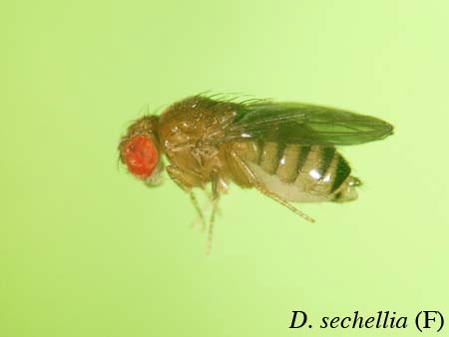
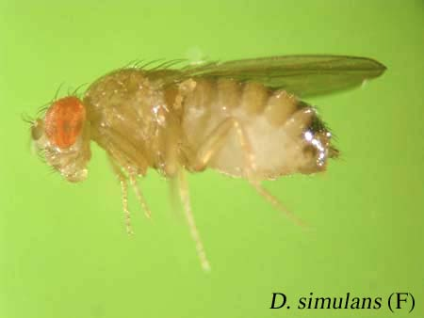
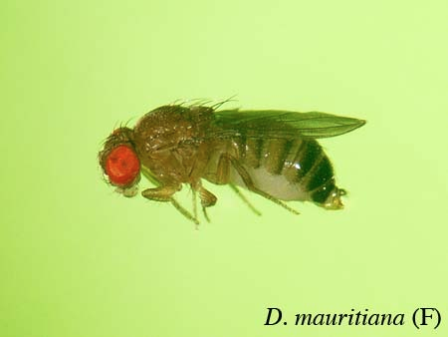
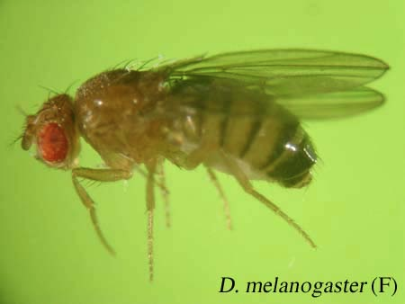
D. simulans species complex
~5 Mya
~250 kya
?
D. sechellia
n=14
D. simulans
n=20
D. mauritiana
D. melanogaster
Garrigan et al. (2012)
Photos: Department of Biology, Faculty of Science, Ehime University

Slide 23
Let’s get to work!

